Slide 1

11th EBL NBO Officers’ Seminar
Survey Results
European Bridge League

Slide 2
11th EBL NBO Officers’ Seminar
Restarting Bridge
European Bridge League

Slide 3
11th EBL NBO Officers’ Seminar
Covid-19 Effects
Over the past 18 months, have you tried to restart Face to Face bridge at least once?
European Bridge League

Slide 4
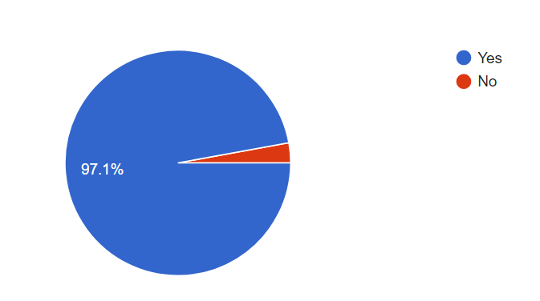
11th EBL NBO Officers’ Seminar
Results
European Bridge League

Slide 5
11th EBL NBO Officers’ Seminar
Covid-19 Effects
We are glad that you are back on track - How did you do it?
European Bridge League

Slide 6
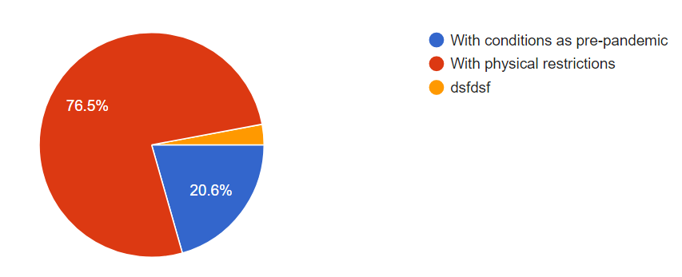
11th EBL NBO Officers’ Seminar
Results
European Bridge League

Slide 7
11th EBL NBO Officers’ Seminar
Covid-19 Effects
What conditions are imposed on venue and players? If Face to Face bridge has been restarted more than once, what lessons were learned and what additional measures were taken on restart?
European Bridge League

Slide 8
11th EBL NBO Officers’ Seminar
Answers
“Super” Green Pass.
Vaccine or Negative test – 24/48 hours before.
Vaccinated players Only.
Respect of distance.
Wearing a mask, hand sanitizer for each table.
No handshakes, No Kisses ☹
Plexi-glass / acrylic separations.
European Bridge League

Slide 9
11th EBL NBO Officers’ Seminar
Answers
Personal Bidding-boxes.
Fresh / duplicated boards.
Cleaning the tables.
Only one player touch the Bridgemates.
Only on player touch the boards.
Information / results only Online.
Ventilation.
European Bridge League

Slide 10
11th EBL NBO Officers’ Seminar
Answers
Limitation of people / playing area.
According to the states protocols.
Lesson 1 – People prefer to stay at home.
Lesson 2 – Rules changed too often.
Lesson 3 – Hard to do long-term planning.
Lesson 4 – Be innovative with solutions.
European Bridge League

Slide 11
11th EBL NBO Officers’ Seminar
Covid-19 Effects
When do you foresee live bridge restarting
European Bridge League

Slide 12
11th EBL NBO Officers’ Seminar
Answers
Summer 22 for NBO.
Clubs already restarted.
European Bridge League

Slide 13
11th EBL NBO Officers’ Seminar
Covid-19 Effects
What effect has the pandemic had on your membership numbers?
European Bridge League

Slide 14
11th EBL NBO Officers’ Seminar
Answers
Dropped by – 10%, 20%, 30%, 37%, 40%, 45%
Low participation.
A lot of player will never return.
European Bridge League

Slide 15
11th EBL NBO Officers’ Seminar
Answers
Not significant.
Gain new online members signing up.
They have increase a little but half of the members are not playing at all.
Positive effect – people could not travel abroad.
European Bridge League

Slide 16
11th EBL NBO Officers’ Seminar
Covid-19 Effects
What effect has the pandemic had on your young player numbers?
European Bridge League

Slide 17
11th EBL NBO Officers’ Seminar
Answers
Numbers are decreasing – 50%.
Most of it – Primary and secondary schools.
Catastrophic.
They prefer to play online.
Same as before / not much changed.
Lower recruitment of new young players.
European Bridge League

Slide 18
11th EBL NBO Officers’ Seminar
Online Activity
Have you developed any initiatives to attract players back to live clubs?
European Bridge League

Slide 19
11th EBL NBO Officers’ Seminar
Answers
No.
Money support for health measures.
Lower entry fees.
Support clubs in their initiatives.
Special price for clubs – Lower
Festival of simultaneous tournaments with promotional rates and more master points.
European Bridge League

Slide 20
11th EBL NBO Officers’ Seminar
Answers
Increase Live master points.
Re-examined our visions.
Create working groups.
Build new package to attract new players.
Focused newsletters.
Special tournament for beginners.
Stopped NBO’s online activity and promote the clubs.
European Bridge League

Slide 21
11th EBL NBO Officers’ Seminar
Good Luck!
European Bridge League

