Slide 1

11th EBL NBO Officers’ Seminar
Survey Results
European Bridge League

Slide 2
11th EBL NBO Officers’ Seminar
General
European Bridge League

Slide 3
11th EBL NBO Officers’ Seminar
General
34 Forms.
27 NBO’s.
Presidents, Board Executive members, CEO, General Secretary, Junior Coach, etc.
European Bridge League

Slide 4
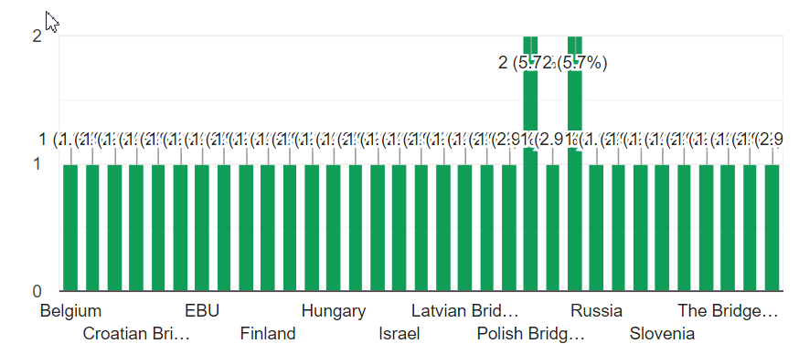
11th EBL NBO Officers’ Seminar
NBO’s
European Bridge League

Slide 5
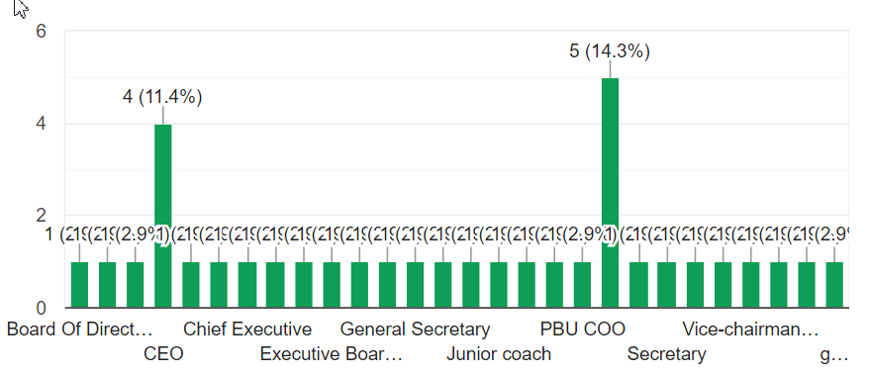
11th EBL NBO Officers’ Seminar
Positions
European Bridge League

Slide 6
11th EBL NBO Officers’ Seminar
NBO’s
Croatia
Cyprus
Czech republic
Denmark
England
Estonia
Finland
France
Germany
Greece
Hungary
Ireland
Israel
Italy
Latvia
Netherland
Norwegian
Poland
Portugal
Romania
Russia
Scotland
Slovakia
Slovenia
Sweden
Belgium, Wales
25 NBO’s.
Board Executive members, CEO, General Secretary, Junior Coach, etc.
European Bridge League

Slide 7
11th EBL NBO Officers’ Seminar
Online Activity
European Bridge League

Slide 8
11th EBL NBO Officers’ Seminar
Online Activity
Have you used any online playing platform? (You can choose more than one)
European Bridge League

Slide 9
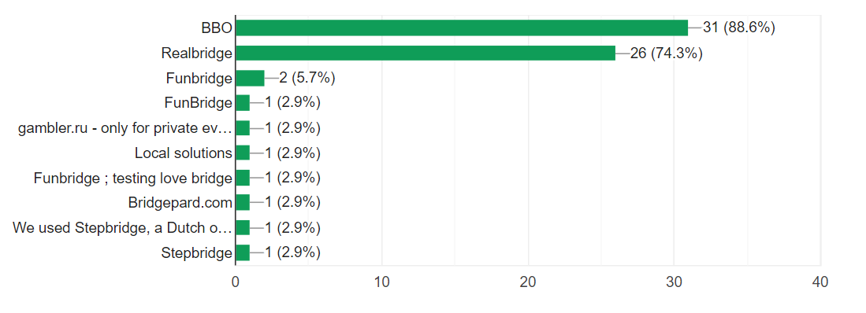
11th EBL NBO Officers’ Seminar
Results
European Bridge League

Slide 10
11th EBL NBO Officers’ Seminar
Online Activity
Have you been able to teach bridge or train club officials/TDs online?
European Bridge League

Slide 11
11th EBL NBO Officers’ Seminar
Answers
Yes – 70%.
Online Bridge Lessons: Zoom, Other Platforms
Effectiveness?
New approach for advertisement: FB, Newsletter.
New kind of students.
Online Bridge training / Tournaments.
European Bridge League

Slide 12
11th EBL NBO Officers’ Seminar
Answers
Combines – F2F -> Online -> F2F.
Hybrid Lessons.
Hybridge Tournaments.
NBO’s & Clubs: Different ways and Supporting.
European Bridge League

Slide 13
11th EBL NBO Officers’ Seminar
Dealing with Online Cheating
European Bridge League

