Slide 1


11th EBL NBO Officers’ Seminar
Dealing with Online Cheating
Gilad Ofir
European Bridge League

Slide 2
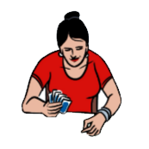
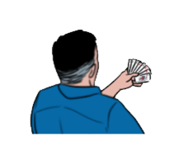

11th EBL NBO Officers’ Seminar
ONLINE CHEATING - THE REAL PANDEMIC
Couples living &
playing together
Thinking too
long
Strange
bidding
Unusual
Play

Slide 3
11th EBL NBO Officers’ Seminar
FAIR PLAY - STATISTICS
REMARKS | COMPLAINTS | YEAR
Fair Play system was launched | 33* (22) | 2016

Slide 4
11th EBL NBO Officers’ Seminar
FAIR PLAY - STATISTICS
REMARKS | COMPLAINTS | YEAR
Fair Play system was launched | 33* (22) | 2016
 | 17 | 2017
 | 15 | 2018
 | 24 | 2019

Slide 5
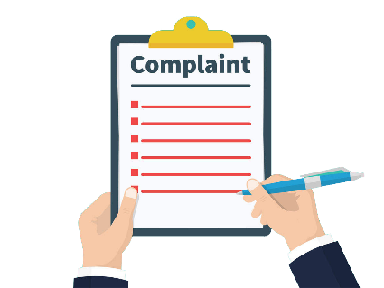
11th EBL NBO Officers’ Seminar
FAIR PLAY - STATISTICS
REMARKS | COMPLAINTS | YEAR
Fair Play system was launched | 33* (22) | 2016
 | 17 | 2017
 | 15 | 2018
 | 24 | 2019
Covid year | 98 | 2020
Lynchternet
European Bridge League

Slide 6
11th EBL NBO Officers’ Seminar
FIRST ONLINE FESTIVAL – STATISTICS
14
12
“We think they are cheating”

Slide 7
11th EBL NBO Officers’ Seminar
FAIR PLAY - STATISTICS
REMARKS | COMPLAINTS | YEAR
Fair-Play system launched | 33* (22) | 2016
 | 17 | 2017
 | 15 | 2018
 | 24 | 2019
Covid year | 98 | 2020
Hybrid year | 36 | 2021

Slide 8

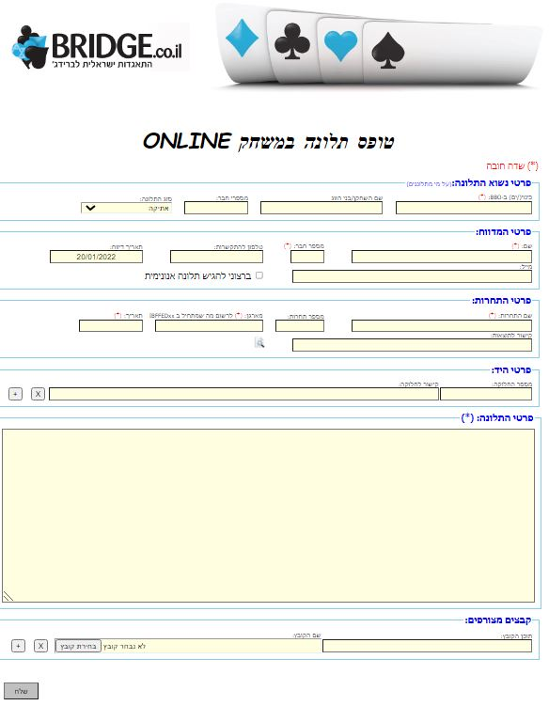

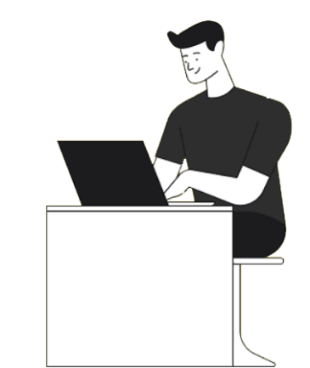

11th EBL NBO Officers’ Seminar
HOW DID WE DEAL WITH THIS NEW LYNCHTERNET EPIDEMIC?
Appeals Court
Special Ethics Committee
Online Form
A reviewer
Rules & Regulations
European Bridge League

Slide 9
11th EBL NBO Officers’ Seminar
PUNITIVE SENTENCING OF THE ETHICS COMMITTEE
Immediate suspension.
1st offense - up to 6 months from all activities.
A recurring offense, up to 12 months from all activities.
Canceling achievements and Master Points
Prevent both players from playing with each other for an unlimited time
If a player found guilty is a certified TD, he would lose his license.
Preventing a player from playing in national teams.
Handling a complaint will take not more than 1 month.
European Bridge League

Slide 10


11th EBL NBO Officers’ Seminar
THE DILEMA OF ONLINE COMPLAINTS
?
14
12

Slide 11
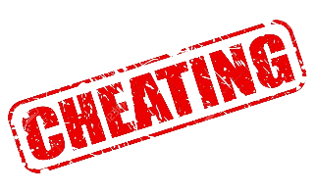
I talked to myself, saying he must bid 2♠ , it’s not my fault he heard me
11th EBL NBO Officers’ Seminar
I swear I wasn’t communicating with my partner, I just went to the toilet
ISSUES WHICH REQUIRED OUR SPECIAL ATTENTION DURING THE LAST 2 YEARS
ONLINE CHEATING - THE REAL PANDEMIC
European Bridge League

Slide 12
11th EBL NBO Officers’ Seminar
COMPLAINT MANAGEMENT STATISTICS
14
12

Slide 13
11th EBL NBO Officers’ Seminar
COMPLAINT MANAGEMENT STATISTICS
14
12

Slide 14
11th EBL NBO Officers’ Seminar
COMPLAINT MANAGEMENT STATISTICS
14
12

Slide 15
11th EBL NBO Officers’ Seminar
COMPLAINT MANAGEMENT STATISTICS
14
12

Slide 16
11th EBL NBO Officers’ Seminar
COMPLAINT MANAGEMENT STATISTICS
14
12

Slide 17
11th EBL NBO Officers’ Seminar
COMPLAINT MANAGEMENT STATISTICS
14
12
Mainly warnings

Slide 18
11th EBL NBO Officers’ Seminar
COMPLAINT MANAGEMENT STATISTICS
10 - Suspensions
5 - Suspensions + Achievements
cancellations
14
12
3 – Handled by the IBF’s court

Slide 19
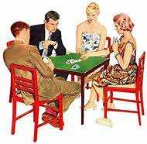
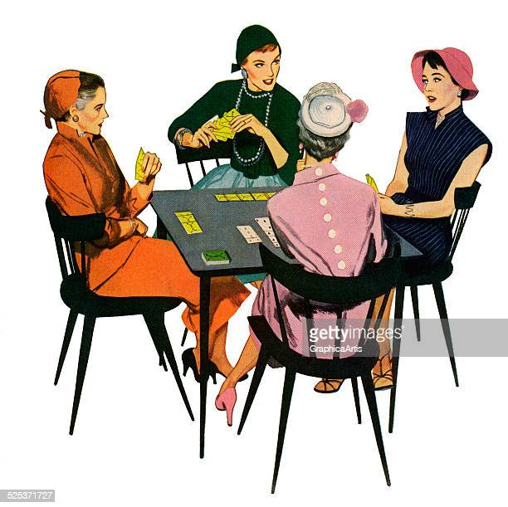
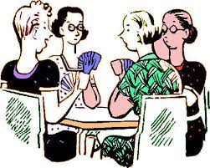
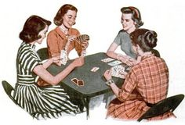
11th EBL NBO Officers’ Seminar
TO PUBLISH OR NOT TO PUBLISH?
Publish anonymously?
European Bridge League

Slide 20
11th EBL NBO Officers’ Seminar
TO SUMMARIZE
European Bridge League

Slide 21

11th EBL NBO Officers’ Seminar
TO SUMMARIZE
The majority of players are trustworthy, and cheaters
are far and few between.
We will not let them
spoil our game!

