Slide 1
BRIDGE IN POLISH SCHOOLs
Agata Kowal

Slide 2
Polish education system until 2017
Elementary school
6 years
7 – 13 y.o. pupils
Compulsory to all children
Gimnazjum
(„Middle School”)
3 years
13-16 y.o. pupils
Compulsory to all children
High school
3 years
17-19 y.o. pupils
exams
exams
In all elementary schools and all gimnazjums, pupils have the same school subjects, but it is optional to create sport classes with one or more sport discipline.

Slide 3
Ministry of Education regulations regarding sport classes in Poland
1. At least 10 hours of physical education and sport per week
2. Participate in at least 1 class for a minimum of 3 years
3. Initial aptitude exam
Gimnazjum was a great place for creating sport classes, especially bridge. So we have created sport classes in Cracow.
Notes:
There is more condition, but this three are most important and hard to meet

Slide 4
Sport bridge class in Gimnazjum in Cracow
In May 2009, 200 children took the initial aptitude exam.
In September 2009, the best 24 of them started playing bridge in Gimnazjum nr 2 in Cracow.

Slide 5
Time required for bridge class
 | Playing bridge | Theory of bridge | Debriefing | physical education | Total per week
first year | 4 lessons | 2 lessons | -------- | 4 lessons | 10
second year | 3 lessons | 2 lessons | 1 lesson | 4 lessons | 10
third year | 6 lessons | 2 lessons | 1 lesson | 4 lessons | 13
all | 13 lessons | 6 lessons | 2 lessons | 12 lessons | 33
.
Notes:
1 lesson = 45 minutes

Slide 6
Weekly plan of bridge class
 | Lesson | Monday |  | Tuesday |  | Wednesday |  | Thursday |  | Friday
1 | 7:30-8:15 |  |  | physics |  | history |  | chemistry |  | p.e
2 | 8:20-9:05 | bridge |  | chemistry |  | music |  | polish |  | p.e
3 | 9:10-9:55 | bridge |  | English |  | p.e |  | polish |  | Spanish
4 | 10:05-10:50 | bridge |  | English |  | p.e |  | bridge |  | Spanish
5 | 10:55-11:40 | math |  | homeroom |  | Polish |  | bridge |  | artist
6 | 11:55-12:40 | biology |  | math |  | Polish |  | bridge |  | math
7 | 12:55-13:40 | religion |  | Polish |  | religion |  | English |  | math
8 | 13:45-14:30 | history |  | Polish |  | geography |  | English |  | geography
Notes:
On the beginig pupils play almost all the time – they take a triks as long as it stay boring for them. Then t

Slide 7
A few numbers about my pupils
Until now we have more than 200 graduates, 50 of them continue to play bridge.
38 of my pupils play in the bridge league in this season
5 of them are Tournament Directors
They have won more than 30 medals in Polish Championships
They won local youth tournaments more than 100 times
4 of them are gold medalists of European Youth Team Championships

Slide 8
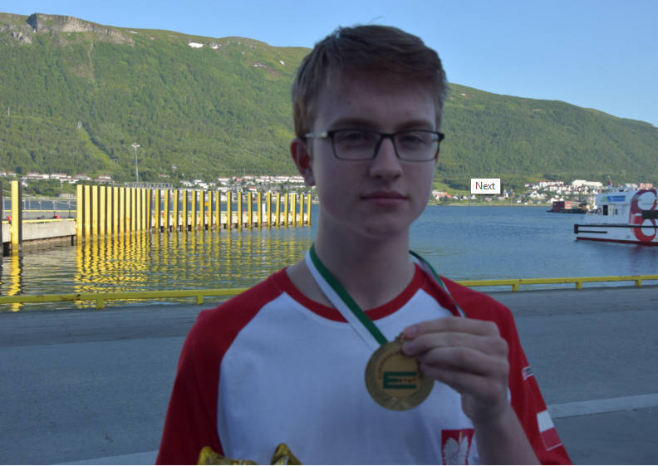
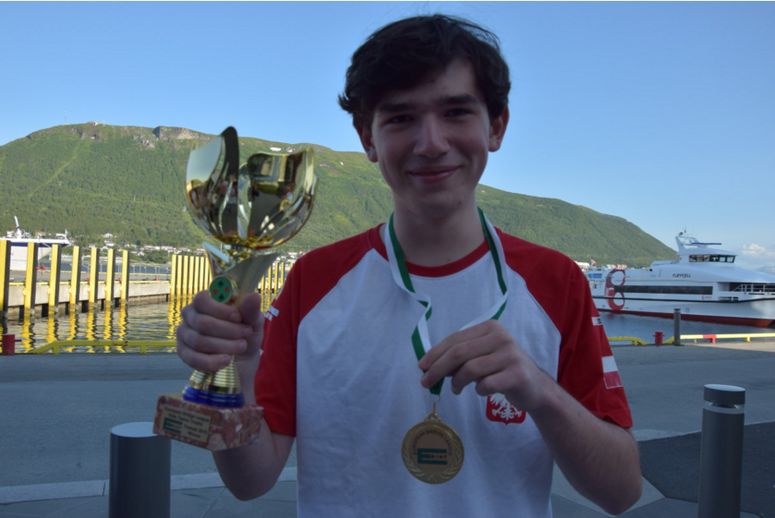
Gold medalists of 25th European Youth Team Championships – Tromso 2015
Mateusz Słuszniak Maciej Kędzierski

Slide 9
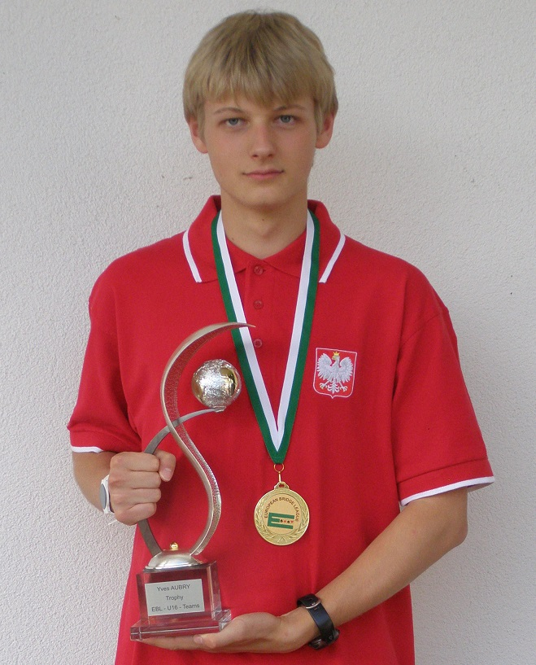
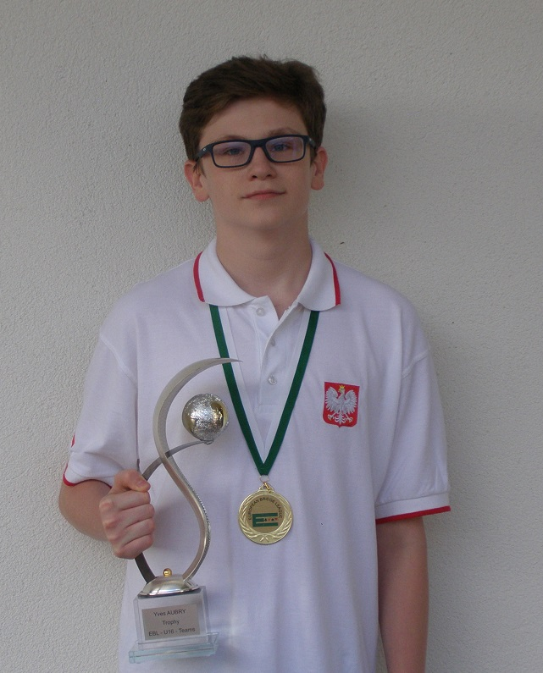
Gold medalists of 26th European Youth Team Championships – Samorin 2017
Bartosz Żbik Przemysław Pasiński

Slide 10
What my pupils learn during bridge lessons besides bridge itself
They have fun – because bridge is a fascinating game ☺
They think all the time
They ask and look for answers
They learn team work
They learn to take a responsibility for their decision
They learn to lose
This is more than they learn during all other subjects
Notes:
I belive that all of it will be usefull for them in theiers lifes and theiers workes.

Slide 11
Do bridge playing pupils have better school results than their peers?
Notes:
I hear this quastion very often. Pupils who play bridge, take exams better then the rest

Slide 12
Results of final exams in Gimnazjum nr 2 in Cracow
Notes:
Gimnazjumn nr 2 is the best school in Cracow. All pupils in our school are inteligent, hard work

Slide 14
I have conducted an experiment with logical tasks
I have chosen 5 logical task and given it 6 group of pupils from our school to solve.
First year pupils who had just started learning bridge.
First year pupils who liked math
First year pupils who didn’t play bridge and did’t like math.
Third year pupils who played bridge well.
Third year pupils who were the best mathematicians at school.
Third year pupils who didn’t play bridge and didn’t like math.
Notes:
I chose 5 logical task and gave it to solve to grup of pupils from our school.

Slide 15
 | task 1 | task 2 | task 3 | task 4 | task 5 | average
 | (%) | (%) | (%) | (%) | (%) | (%)
first year bridge pupils | 67 | 24 | 60 | 80 | 0 | 46
first year pupils who like math | 75,5 | 5 | 67 | 87 | 0 | 47
the rest of first year pupils | 65 | 10 | 58 | 80 | 0 | 43
third year bridge pupils | 92 | 48 | 79 | 100 | 14 | 67
third year who like math | 86 | 31 | 72 | 100 | 14 | 60
the rest of third years pupils | 87 | 3 | 57 | 73 | 0 | 44

Slide 16
Polish education system now
Elementary school
8 years
7 – 15 y.o. pupils
Compulsory to all children
High school
exams
Notes:
Last year our parlament changed education system, I will tell aobut it later

Slide 17
Future of teaching bridge in Polish schools after 2017
How to teach bridge to younger children?
Should we start teaching bridge to older elementary school pupils?
Are sport classes the best way to teach bridge?
…

