Slide 1
Bridge School Dubrovnik
A guide by Frano Jancic

Slide 2
Structure
3 teachers
Senior centre 2h/week
Gymnasium 3h/month
Supervised tournament once a week 12/15 boards

Slide 3
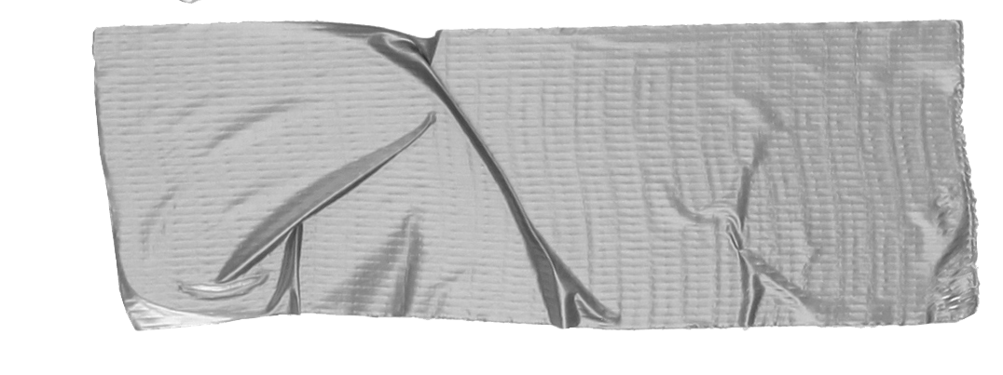

Program
Whist
Trumps, tricks, leads, signals
Auction Bridge
Dummy, points.
Bridge
Game & slam bonuses, penalties
PLAY IN CLUB TOURNAMENT ON 4TH DATE

Slide 4
Wide Street Bidding
Balance hand
Unbalanced hand
Tip
Two opening hands / game must be bid

Slide 5
No No Trump Opening
(Too good to be true)
Only Penalty Doubles
(Life is to short)

Slide 6
Problems
Not enough mentors to be first time partners
Attract players to club play
How to improve from bridge school to club?
Quotes for illustration purposes only

