Slide 1
Hand evaluation – loser tricks
Bridge lecture – intermediate
by Milan Macura
July 17, 2018

Slide 2
Standard evaluation methods
High card points
Loser tricks (LT)
High card points + distributional points
Playing tricks (PT)

Slide 3
How many losers do we have in the suit?
♠ xx
♠ AJx
♠ Qxx
♠ xxx
♠ AJxx
♠ Kxx
♠ QJx
♠ xxxx
♠ KQx
♠ Axxxx

Slide 4
The LT method works very well with:
Unbalanced hands with major suits.
Works perfectly with super unbalanced hands.
We use it also when preempting, using the 3221 rule for losers → we count our losers and using 3221 rule we choose the level where we can preempt.

Slide 5
Relation between
HCP and LT
3+ to -5 HCP 11 LT
5+ to -7 HCP 10 LT
7+ to -9 HCP 9 LT
9+ to -12 HCP 8 LT
12+ to -14 HCP 7 LT
14+ to -16 HCP 6 LT
16+ to -18 HCP 5 LT
18+ to -20 HCP 4 LT

Slide 6
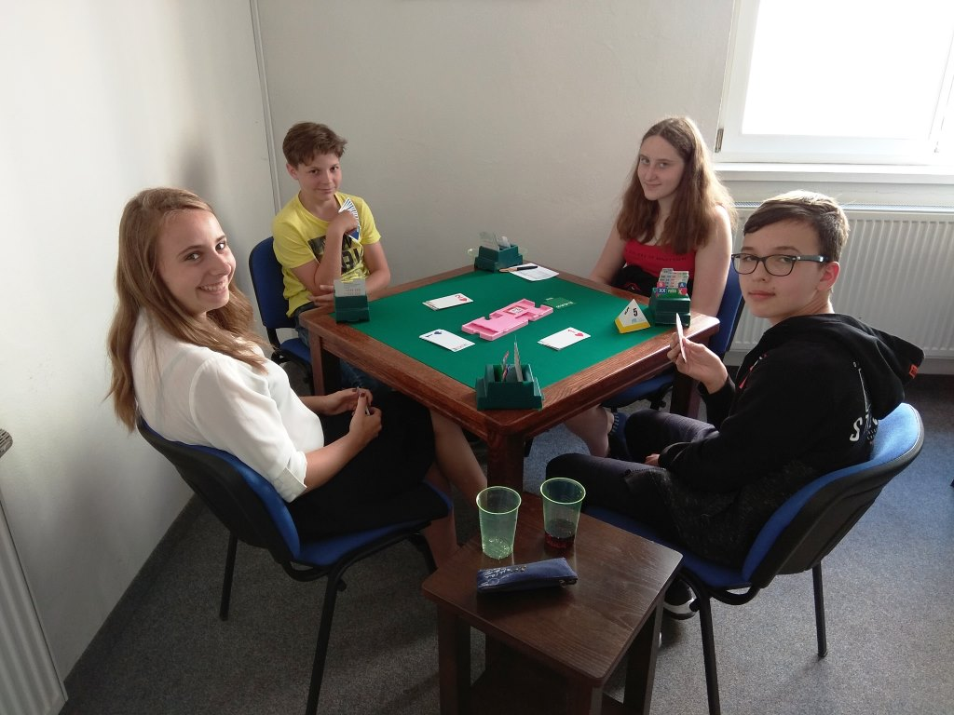
Lets play some boards

Slide 7
Board 25 - analysis
Board: 25
Dealer: N
VUL: EW
♠ 65
♥ AQ432
♦ AQ1085
♣ 2
N
E
S
W
pass
pass
1♠
pass
1NT
pass
3♦
pass
♠ J109
♥ KJ10
♦ 63
♣ J10984
N
♠ Q87
♥ 9876
♦ 4
♣ KQ765
5♦
pass
pass
pass
W
E
S
♠ AK432
♥ 5
♦ KJ972
♣ A3

Slide 8
Board 26 - analysis
Board: 26
Dealer: E
VUL: ALL
♠ 10
♥ A1098
♦ 983
♣ K9876
N
E
S
W
pass
pass
1♠
pass
2♠
pass
3♥
♠ AK863
♥ KQ32
♦ K76
♣ J
N
♠ QJ94
♥ 54
♦ A54
♣ 10432
pass
4♠
pass
pass
W
E
pass
S
♠ 752
♥ J76
♦ QJ102
♣ AQ5

Slide 9
Board 27 - analysis
Board: 27
Dealer: S
VUL: -
♠ 102
♥ QJ106
♦ A54
♣ K762
N
E
S
W
1♥
pass
3♥
pass
4♥
pass
♠ QJ6
♥ 98
♦ K1092
♣ QJ93
N
♠ K954
♥ 73
♦ J8
♣ A10854
pass
pass
W
E
S
♠ A873
♥ AK542
♦ Q763
♣ -

Slide 10
Board 28 - analysis
Board: 28
Dealer: W
VUL: NS
♠ 83
♥ AQJ104
♦ 6
♣ K9642
N
E
S
W
1♠
2♠
3♠
4NT
pass
♠ AK10542
♥ 63
♦ A9743
♣ -
N
♠ QJ96
♥ 852
♦ KQ5
♣ J105
5♣
pass
pass
5♠
W
E
6♣
pass
pass
dbl
S
♠ 7
♥ K97
♦ J1082
♣ AQ873
pass
pass
pass

Slide 11
Board 29 - analysis
Board: 29
Dealer: S
VUL: NS
♠ -
♥ KJ97
♦ 65432
♣ K965
N
E
S
W
1♠
pass
1NT
pass
2♥
pass
♠ KJ876
♥ -
♦ QJ107
♣ Q1098
N
♠ Q109
♥ 65432
♦ AK98
♣ J
3♥
pass
4♥
pass
W
E
pass
pass
S
♠ A5632
♥ AQ108
♦ -
♣ A432

Slide 12
Board 30 - analysis
Board: 30
Dealer: E
VUL: All
♠ 32
♥ AK432
♦ A65
♣ 987
N
E
S
W
1♠
pass
2♥
pass
3♠
pass
4♠
♠ 65
♥ Q87
♦ Q43
♣ AKJ109
N
♠ 987
♥ J109
♦ 10987
♣ 432
pass
pass
pass
W
E
S
♠ AKQJ104
♥ 65
♦ KJ2
♣ Q5

Slide 13
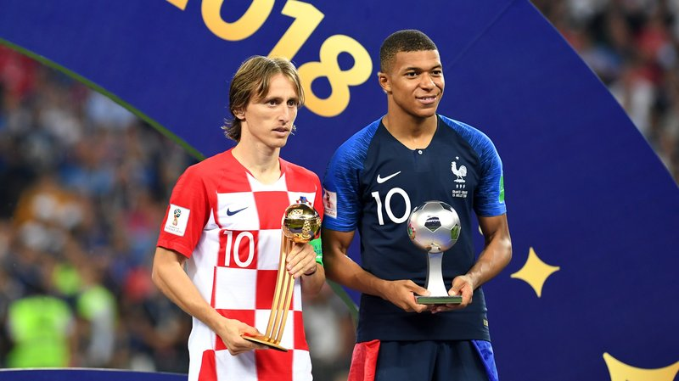
Remember – only evaluating your hand well makes you an expert player

