Slide 1
Hand evaluation – loser tricks
Bridge lecture – intermediate
by Milan Macura
July 17, 2018

Slide 2
What features of your hand can you consider during or even before the bidding?
High card points (HCP)
Distribution
Length
Shortnesses
Extra trumps
Key cards
Type of honors
Position of honors
Defensive tricks
Loser tricks
Evaluating your hand well is essential for the bidding and reaching the right contract

Slide 3
Standard evaluation methods
High card points
Loser tricks (LT)
High card points + distributional points
Playing tricks (PT)

Slide 4
Definition of a loser trick (LT)
In theory (bidding): its a card which we are most likely to lose – missing honors
In practice (when dummy comes down): its a card we are going to lose if partner is not covering it
How do we count losers?
We count 1 LT for every missing honor in the suit A, K or Q, which we are missing based on length in the suit

Slide 5
How to count the losers in one suit
Singleton:
Ace: no loser
Any other: 1 loser

Slide 6
How to count the losers in one suit
Singleton:
A: no loser
x: 1 loser
Doubleton:
AK: no losers
Ax/Kx: 1 loser
xx: 2 losers
Qx: 2 losers

Slide 7
How to count the losers in one suit
3 cards:
AKQ: no losers
AKx/ AQx / KQx: 1 loser
Axx / Kxx / Qxx: 2 losers
xxx / Jxx: 3 losers

Slide 8
How to count the losers in one suit
3 cards:
AKQ: no losers
AKx/ AQx / KQx: 1 loser
Axx / Kxx / Qxx: 2 losers
xxx / Jxx: 3 losers
4+ cards:
Axxx 2 losers
AQxxx 1 loser
4th/5th card are never losers

Slide 9
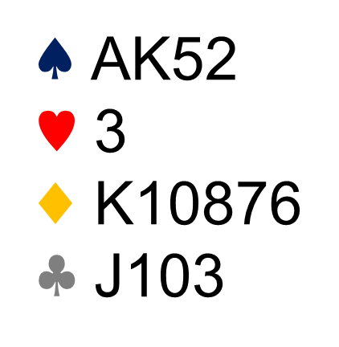
Example of a full hand

Slide 10
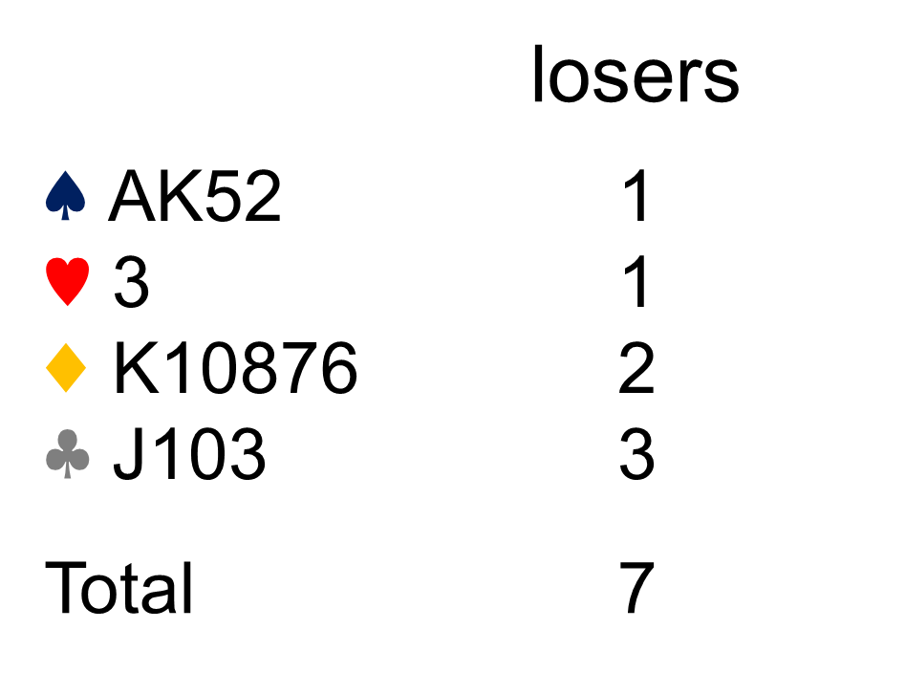
Example of a full hand

Slide 11
When to use losers
Not with balanced hands
Sometimes with standard/semi unbalanced hands
Always with extreme hands

Slide 12
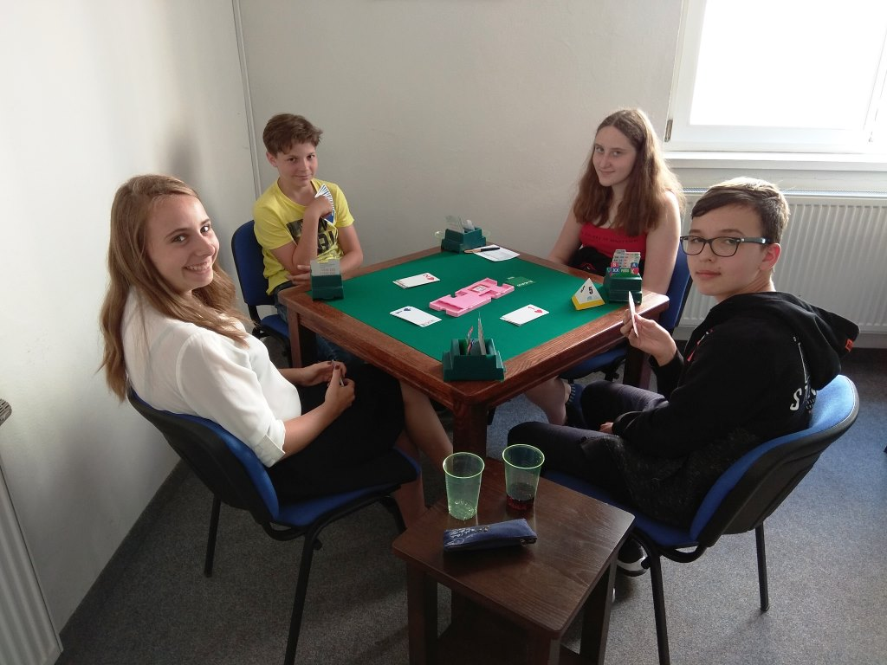
Lets play some boards

Slide 13
Board 25 - analysis
Board: 25
Dealer: N
VUL: EW
♠ KQ652
♥ A92
♦ AJ75
♣ 6
N
E
S
W
1♠
pass
3♠
pass
4♠
pass
pass
pass
♠ 87
♥ KJ3
♦ Q98
♣ QJ1052
N
♠ 104
♥ Q10764
♦ K103
♣ K97
W
E
S
Lead
♠ AJ93
♥ 85
♦ 642
♣ A843
4♡

Slide 14
Board 26 - analysis
Board: 26
Dealer: E
VUL: ALL
♠ J9
♥ A1053
♦ K43
♣ J1093
N
E
S
W
1♠
pass
2♠
pass
3♠
pass
4♠
♠ Q105
♥ 864
♦ 987652
♣ A
N
♠ AK8762
♥ KQ9
♦ 10
♣ K64
pass
pass
pass
W
E
S
Lead
♠ 43
♥ J72
♦ AQJ
♣ Q8752
2♣

Slide 15
Board 27 - analysis
Board: 27
Dealer: S
VUL: -
♠ A8643
♥ 8752
♦ K5
♣ 92
N
E
S
W
1♢
pass
1♠
pass
3♠
pass
♠ Q2
♥ KJ64
♦ 763
♣ KJ105
N
♠ J9
♥ AQ103
♦ 982
♣ Q843
4♠
pass
pass
pass
W
E
S
Lead
♠ K1075
♥ 9
♦ AQJ104
♣ A76
♣4

Slide 16
Board 28 - analysis
Board: 28
Dealer: W
VUL: NS
♠ 76
♥ AK85
♦ K103
♣ 10876
N
E
S
W
1♢
pass
1♠
pass
2♠
♠ AQJ8
♥ J104
♦ A7652
♣ 4
N
♠ K542
♥ Q32
♦ QJ4
♣ QJ5
pass
pass
pass
W
E
S
Lead
♠ 1093
♥ 976
♦ 98
♣ AK932
A♣

Slide 17
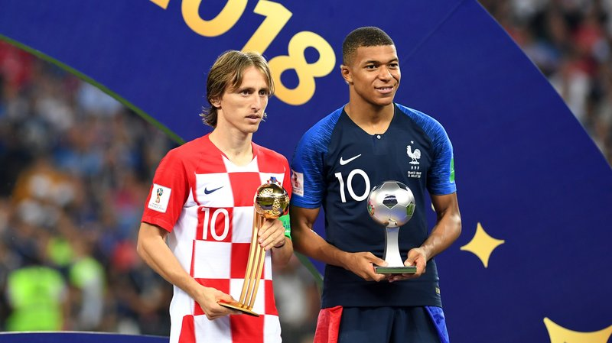
Remember – only evaluating your hand well makes you an expert player

