Slide 1
Hand evaluation
Bridge lecture – intermediate
by Milan Macura
July 16, 2018

Slide 2
What features of your hand can you consider during or even before the bidding?
High card points (HCP)
Distribution
Length
Shortnesses
Extra trumps
Key cards
Type of honors
Position of honors
Defensive tricks
Loser tricks
Eveluating your hand well is essential for the bidding and reaching the right contract

Slide 3
Standard evaluation methods
High card points
Loser tricks (LT)
High card points + distributional points
Playing tricks (PT)

Slide 4
High card points and distributional points
Distributional points - shortnesses
High card points
A
K
Q
J
8
4
+1 DP
4
3
2
1
5
+2 DP
Distributional points - length
A
Q
9
4
3
2
-
+3 DP
+1 DP
+1 DP

Slide 5
Adding partners HCP to our HCP gives us so call game balance
We can get the game balance also from opponents bidding – we can figure out the strength of our partner → 40 - Opps points maximum = our partnership minimum.
Balanced balance = 18-22 HCP → we fight for partscore contract (2nd or 3rd level)
Small advantage = 23-24 HCP → we play at least partscore or double opps on higher level, game with good distribution
Big advantage = 25+ HCP → we play game or double opponents

Slide 6


How can we divide hands according distribution?
Balanced
Unbalanced
Without Major
With Major
1-suiter
2-suiter
3-suiter
We count HCP only (+1 for 5card, -1 for 4333)
Standard – count HCP +2 DP with Major fit
Without fit in Major, we play NT
With 8+ fit
in Major,
we play trumps
6 3 2 2
6 3 3 1
5 4 2 2
5 4 3 1
4 4 4 1
5 4 3 1
4 3 3 3
4 4 3 2
5 3 3 2
4 4 3 2
4 4 3 2
5 3 3 2
Special – Combination of HCP+DP and LT/PT
6 4 (2 1/3 0)
7 3 2 1
7 2 2 2
6 4 (2 1/3 0)
5 5 2 1
5 5 3 0
6 4 3 0
5 4 4 0
Extreme – evaluate only with LT / PT
8 (2 2 1/3 2 0)
7 4 (1 1/2 0)
9+
6 5 (1 1/2 0)
7 4 (1 1/2 0)
7 5 / 8 5
Bid and repeat your suit
First longer 5(6) (higher if 55) then shorter 4(5) (lower if 55)

Slide 7
We divide the HCP in primary and secondary values:
Primary values are Aces and Kings → they get tricks in first 2 rounds of the suit (they stop the opponents cashing their suit quickly)
Secondary values are Queens and Jacks → they get tricks only in combination with A or K or if the opponents start to play the suit. They are more useful in NT and in defense in opps long suits.
A > 2xQ
A > 4xJ
2xK > 3xQ > 2xQ+2xJ
AK > KQJJ

Slide 8
High card points are much more useful if they are in the long suits
An honor in the long suits helps
Promoting middle cards
Establishing the length tricks
Honors in short suits
Can win just the single trick, they don’t have extra value
AJxxx > AJ
KQxx > KQx
QJxxx > QJx
...

Slide 9
Honors are more valuable if they are concentrated in the same suit
In case of having all 4 honors in one suit, we have 4 sure tricks
In case they are split into more suits, they have lower trick potential
Honor concentration helps taking tricks on lower cards using finessing technique.
KQxx > Kxx + Qxx
AQJx > Axx + QJx
KJ10x > Kxx + J10x

Slide 10
The middle cards 10s and 9s can improve the hand very much (sometimes also 8s and 7s
They support the honors in finessing situations
The are much easier to establish as length tricks
AQ109 > AQ32
KJ98 > KJ54
AJ109 > AJ63

Slide 11
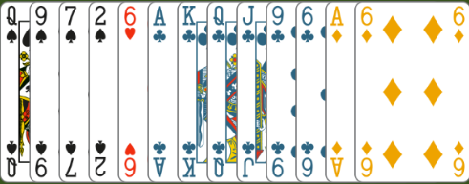
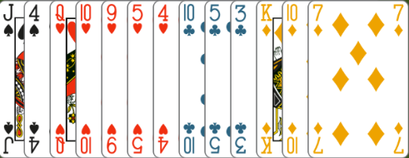
Evaluate the hands

Slide 12
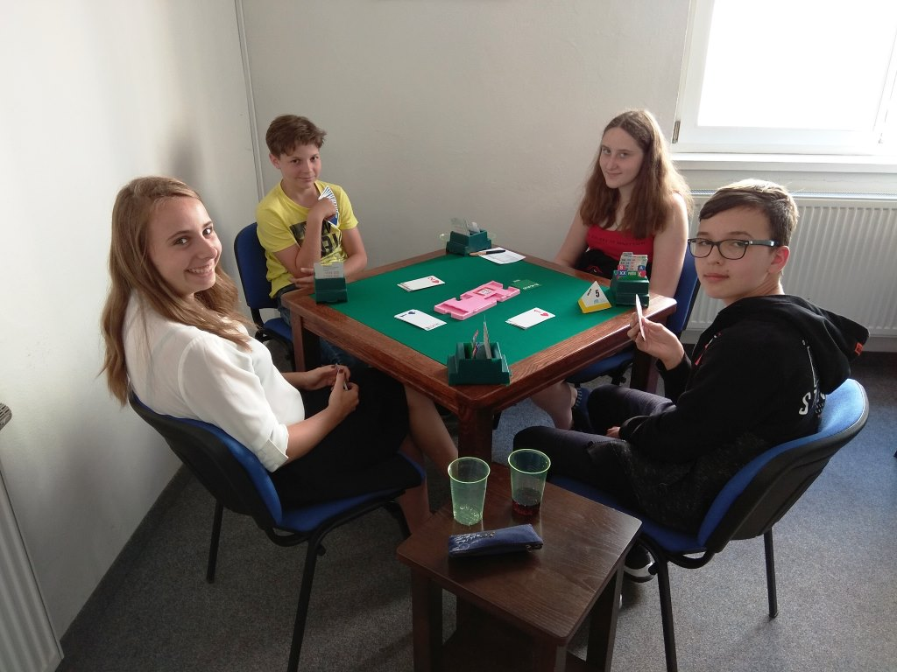
Lets play some boards

Slide 13
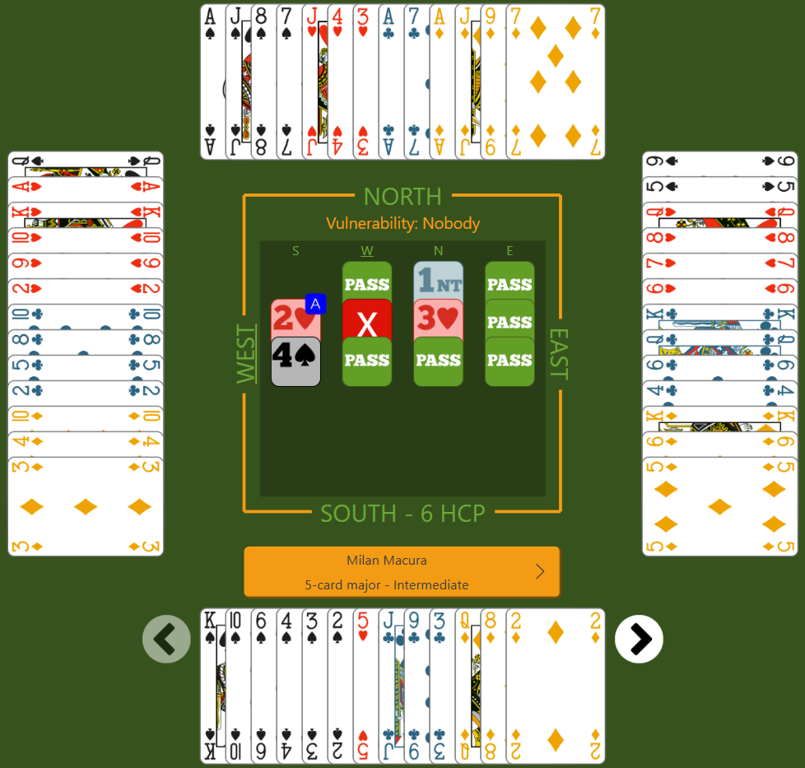
Board nr. 1

Slide 14
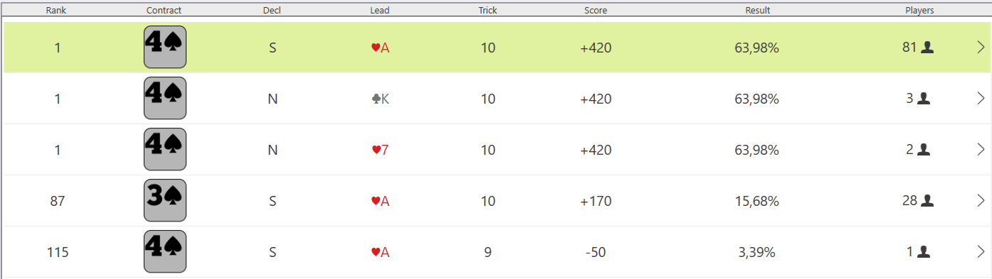
Board nr. 1 scores

Slide 15
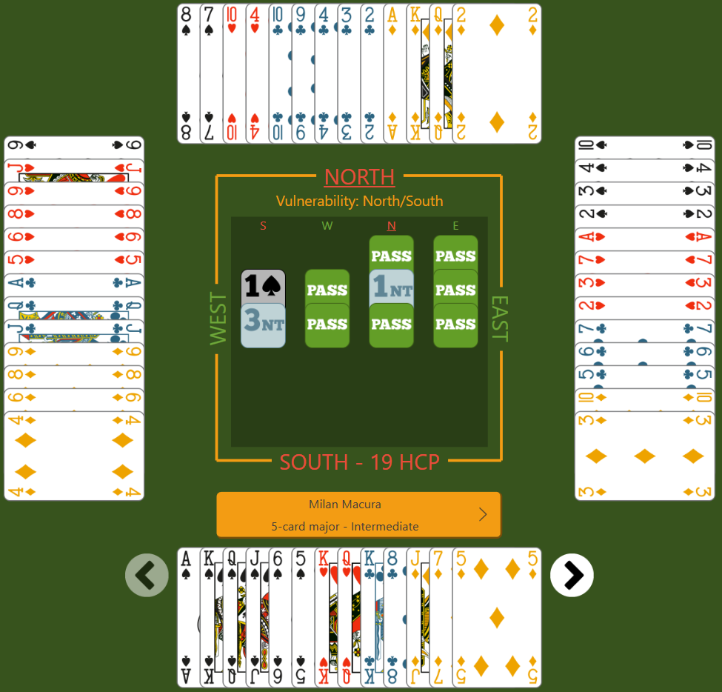
Board nr. 2

Slide 16
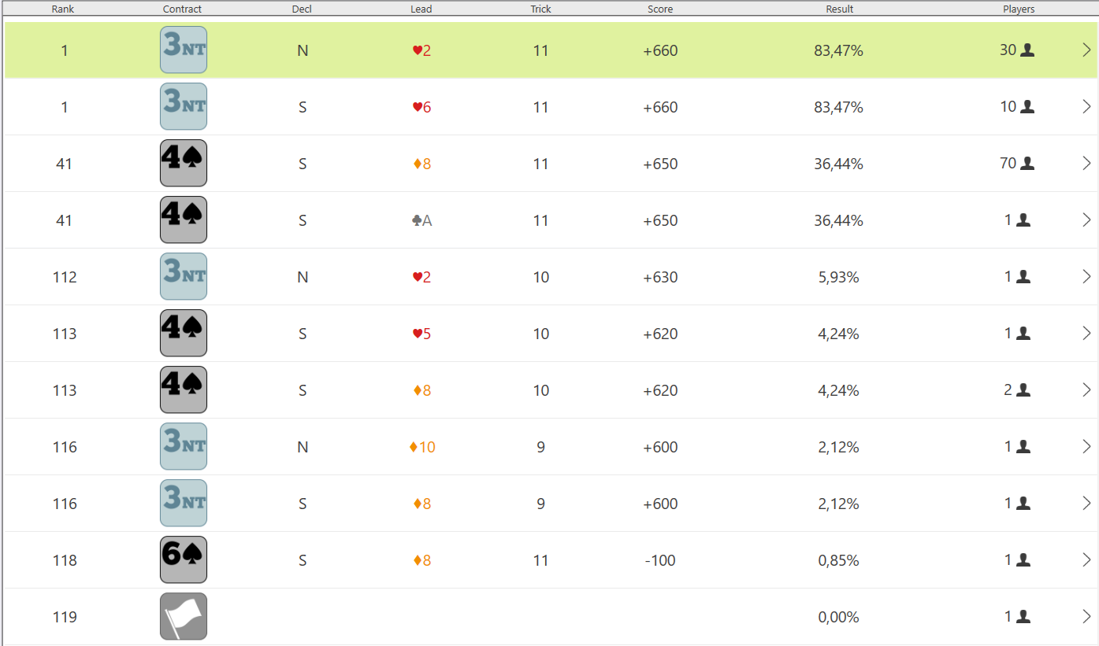
Board nr. 2 scores

Slide 17
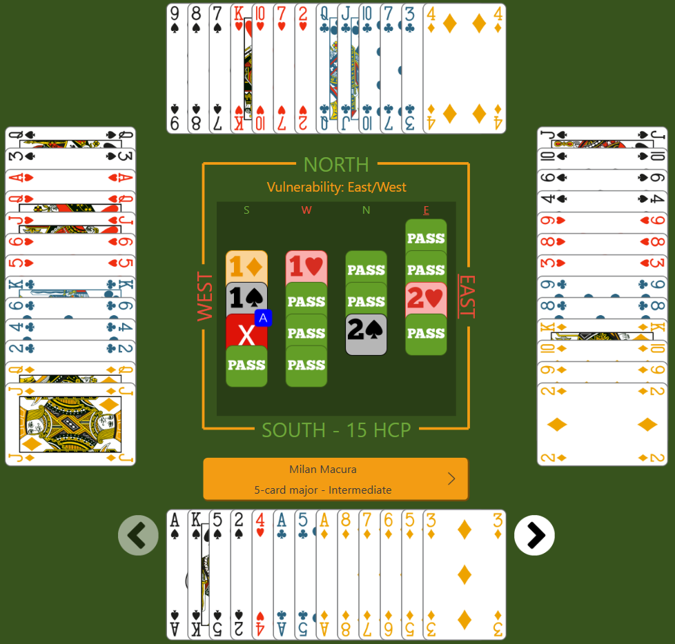
Board nr. 3

Slide 18
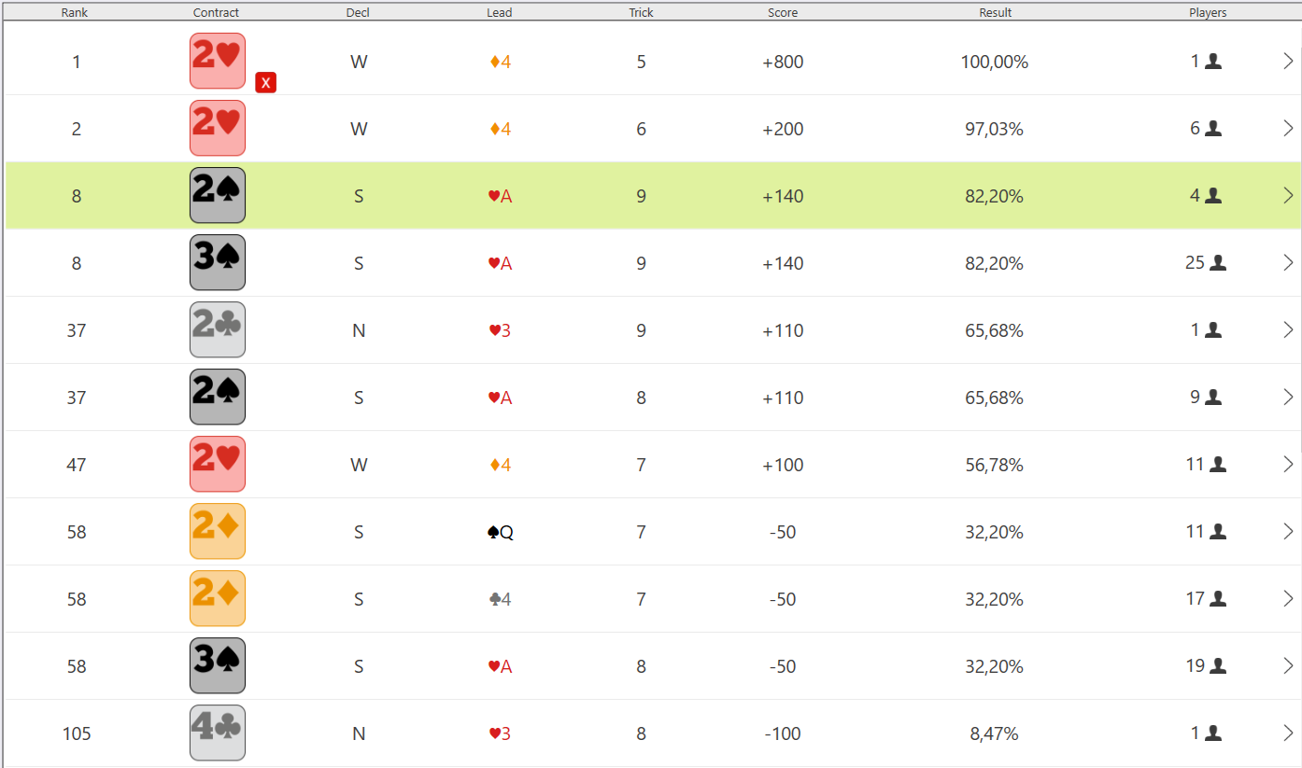
Board nr. 3 scores

Slide 19
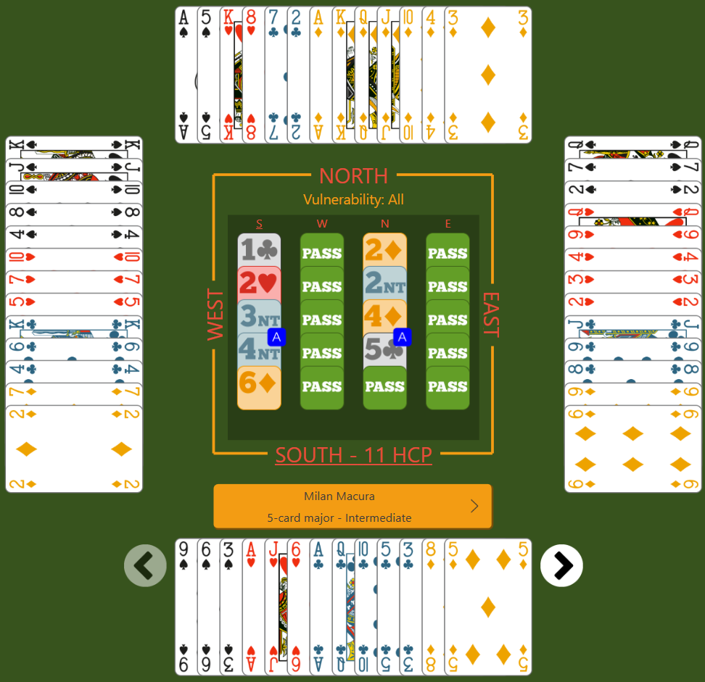
Board nr. 4

Slide 20
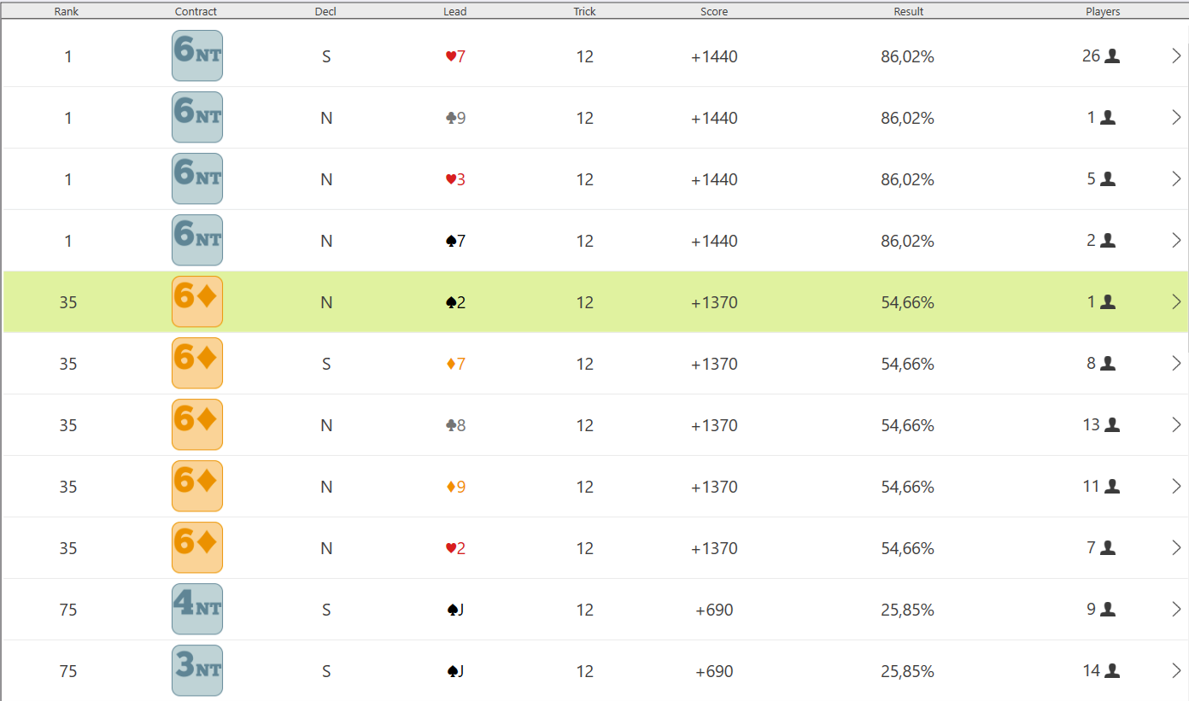
Board nr. 4 scores

Slide 21
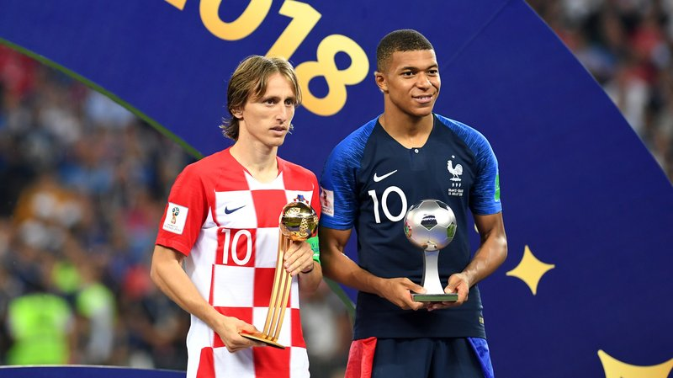
Remember – only evaluating your hand well makes you an expert player

Slide 22
Template for the board presentation
Board: 2
Dealer: E
VUL: N/S
♠ AKQ2
♥ AKQ
♦ AKQ
♣ 432
N
E
S
W
1NT
pass
2♣
pass
2♦
pass
3NT
pass
♠ AKQ2
♥ AKQ
♦ AKQ
♣ 432
N
♠ AKQ2
♥ AKQ
♦ AKQ
♣ 432
pass
pass
W
E
S
Lead
♠ AKQ2
♥ AKQ
♦ AKQ
♣ 432
K♠

Slide 23
Template for the board presentation
Board: 1
Dealer: N
VUL: none
♠ AKQ2
♥ AKQ
♦ AKQ
♣ 432
N
E
S
W
1NT
pass
2♣
pass
2♦
pass
3NT
pass
♠ AKQ2
♥ AKQ
♦ AKQ
♣ 432
N
♠ AKQ2
♥ AKQ
♦ AKQ
♣ 432
pass
pass
W
E
S
Lead
♠ AKQ2
♥ AKQ
♦ AKQ
♣ 432
K♠

Slide 24
Template for the board presentation
Board: 3
Dealer: S
VUL: E/W
♠ AKQ2
♥ AKQ
♦ AKQ
♣ 432
N
E
S
W
1NT
pass
2♣
pass
2♦
pass
3NT
pass
♠ AKQ2
♥ AKQ
♦ AKQ
♣ 432
N
♠ AKQ2
♥ AKQ
♦ AKQ
♣ 432
pass
pass
W
E
S
Lead
♠ AKQ2
♥ AKQ
♦ AKQ
♣ 432
K♠

Slide 25
Template for the board presentation
Board: 4
Dealer: W
VUL: all
♠ AKQ2
♥ AKQ
♦ AKQ
♣ 432
N
E
S
W
1NT
pass
2♣
pass
2♦
pass
3NT
pass
♠ AKQ2
♥ AKQ
♦ AKQ
♣ 432
N
♠ AKQ2
♥ AKQ
♦ AKQ
♣ 432
pass
pass
W
E
S
Lead
♠ AKQ2
♥ AKQ
♦ AKQ
♣ 432
K♠

