Slide 1
Planning the play in suit ♣♦♥♠
3rd lecture

Slide 2
1st rule
PLAN THE PLAY!!!

Slide 3
2nd rule
PLAN THE PLAY BEFORE PLAYING THE FIRST TRICK!!!

Slide 4
Plan the play?
How many tricks?
How many I can cash immediately?
How can I get more tricks?

Slide 5
4 ways how to make tricks
TOP TRICKS
RUFFING
FINESS
DEVELOPING LONG SUIT

Slide 6
Count the losers
Long hand
Count the losers in the long hand
Then see how many you can cover from the other hand

Slide 7
How many losers on this deal?

Slide 8
Count to 13
Draw trumps! But count the trumps!
Do not draw unnecessary trumps, they can be useful later

Slide 9
Ruff
Extra tricks in shorter hand made by ruffing
♠AKQJ10; ♦A32
♠987; ♦4

Slide 10
Finess
Gaining more tricks by putting missing card in one opponents hand
♠ A Q
♠ 7 2

Slide 11
Ruffing finess
Opponent does not have any more trumps and NS can take all tricks if E holds the ace of spades
♠ | K Q J
♥ | —
♦ | —
♣ | A
N S
♠ | —
♥ | 2
♦ | 3 2
♣ | 2

Slide 12
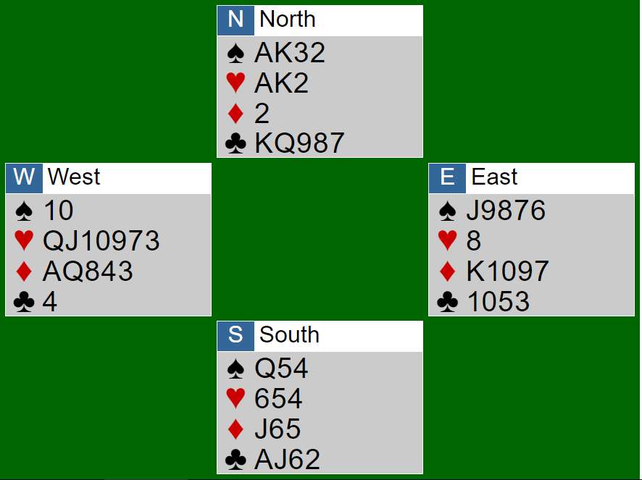
Drawing trumps (NS) 5♣

Slide 13
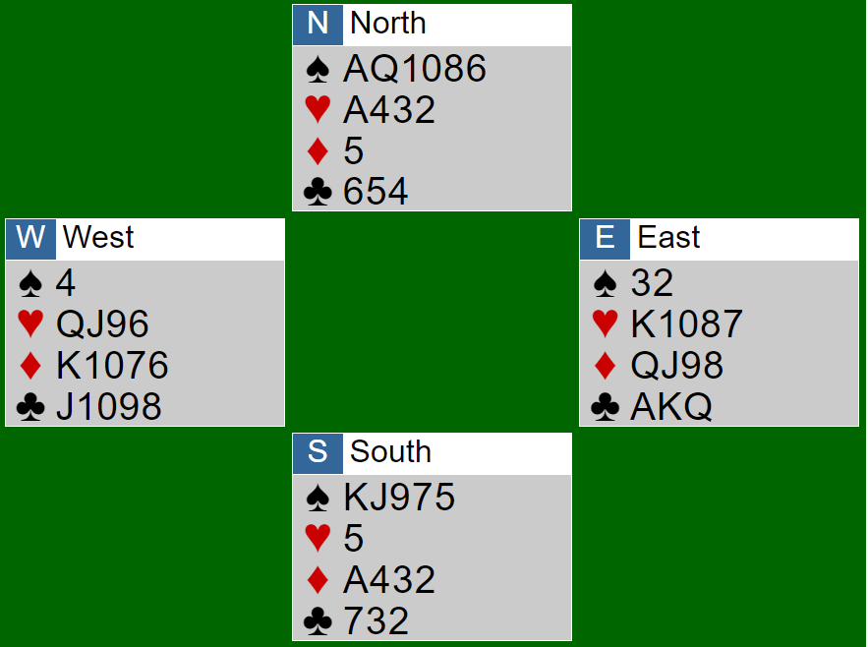
Draw trumps, then crossruff (NS) 4♠

Slide 14
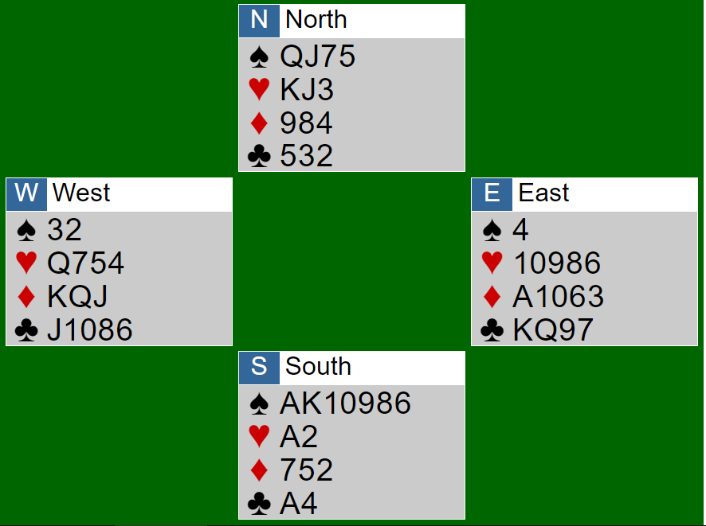
Finessing (NS) 4♠

Slide 15
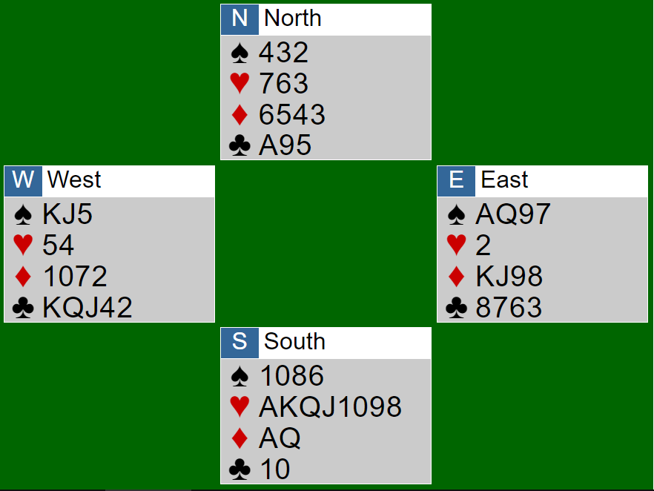
Finessing and entry management (NS) 4♥

Slide 16
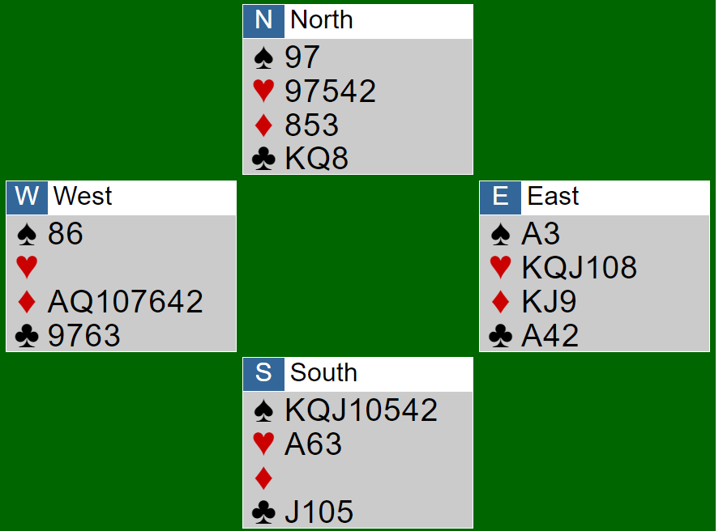
Ruffing finess (EW) 5♦

Slide 17
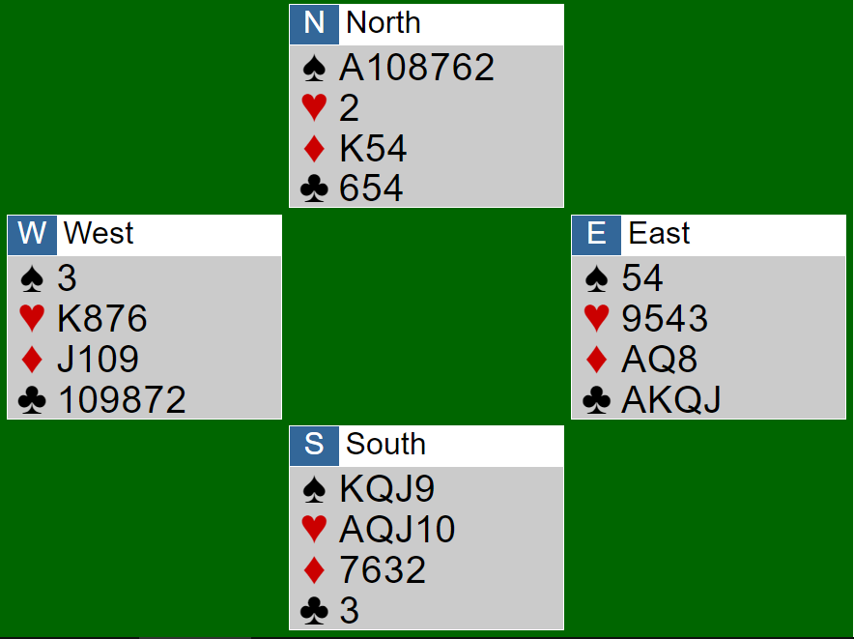
Ruffing finess (NS) 4 ♠

Slide 18
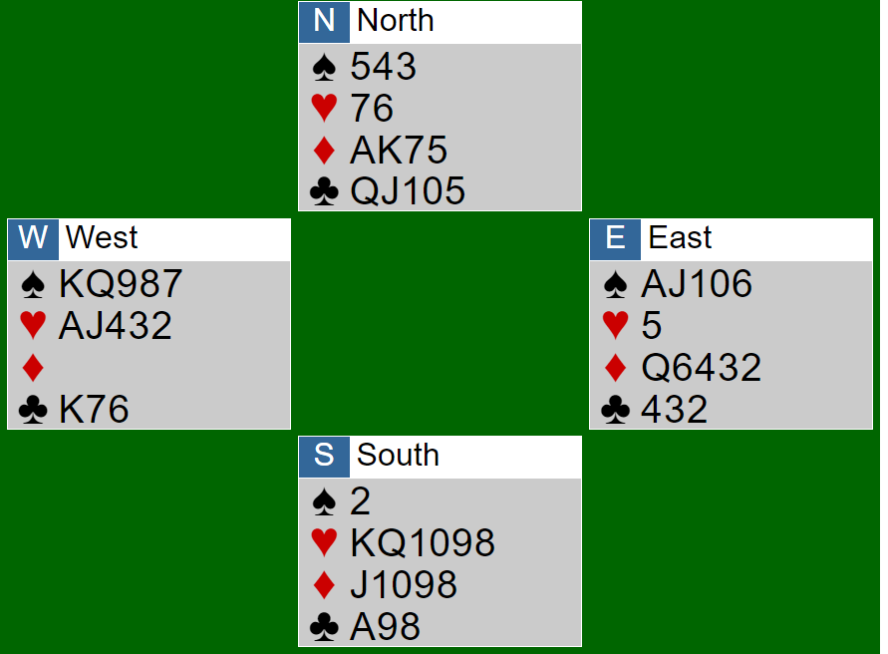
Do not draw trumps, crossruffing (EW) 4♠

